Slide 1
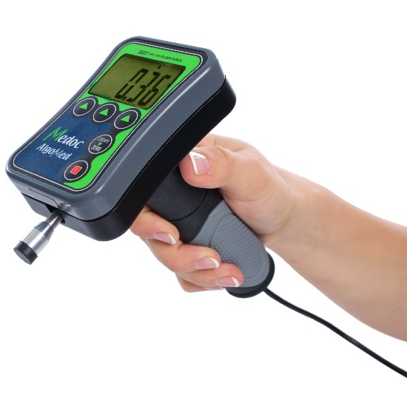
AlgoMed
Introduction & Applications

Slide 2

Overview – AlgoMed Device
Software-based computerized algometer
Allows Pressure Pain Threshold (PPT) assessment performed with standardized QST method
Offers real-time feedback to control & monitor applied pressure stimulus quality
Notes:
Conversion of pressure = newton per square meter is pascal force per area unit units - psi = pounds per square inch - sengpielaudio Sengpiel Berlin. The SI unit of the pressure is the pascal with the formula sign Pa. 1 Pascal is equal to thepressure of 1 newton per square meter.

Slide 3
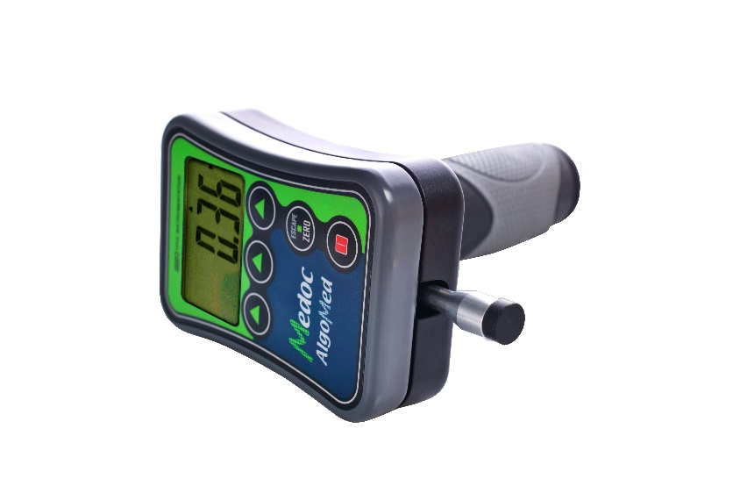
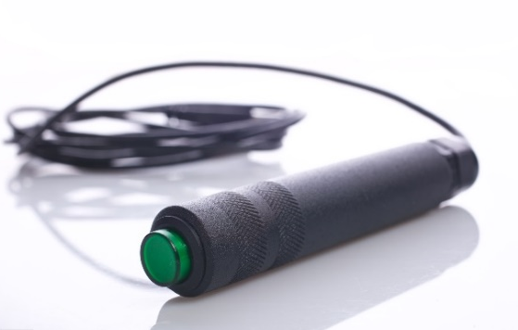
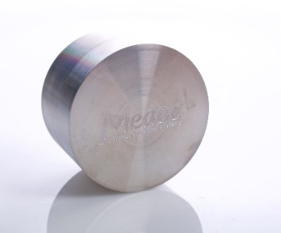
Setup – AlgoMed Components
AlgoMed device components:
  Standard Rubber Tip (contact area – 1cm²)
  Optional probes: 2cm² and 0.5 cm²
  Device Handle
  Patient Response Unit
  Calibration weight
  Connects to the PC via USB

Slide 4
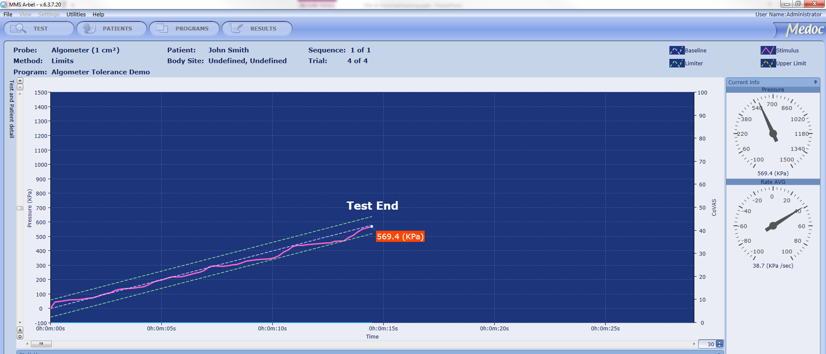
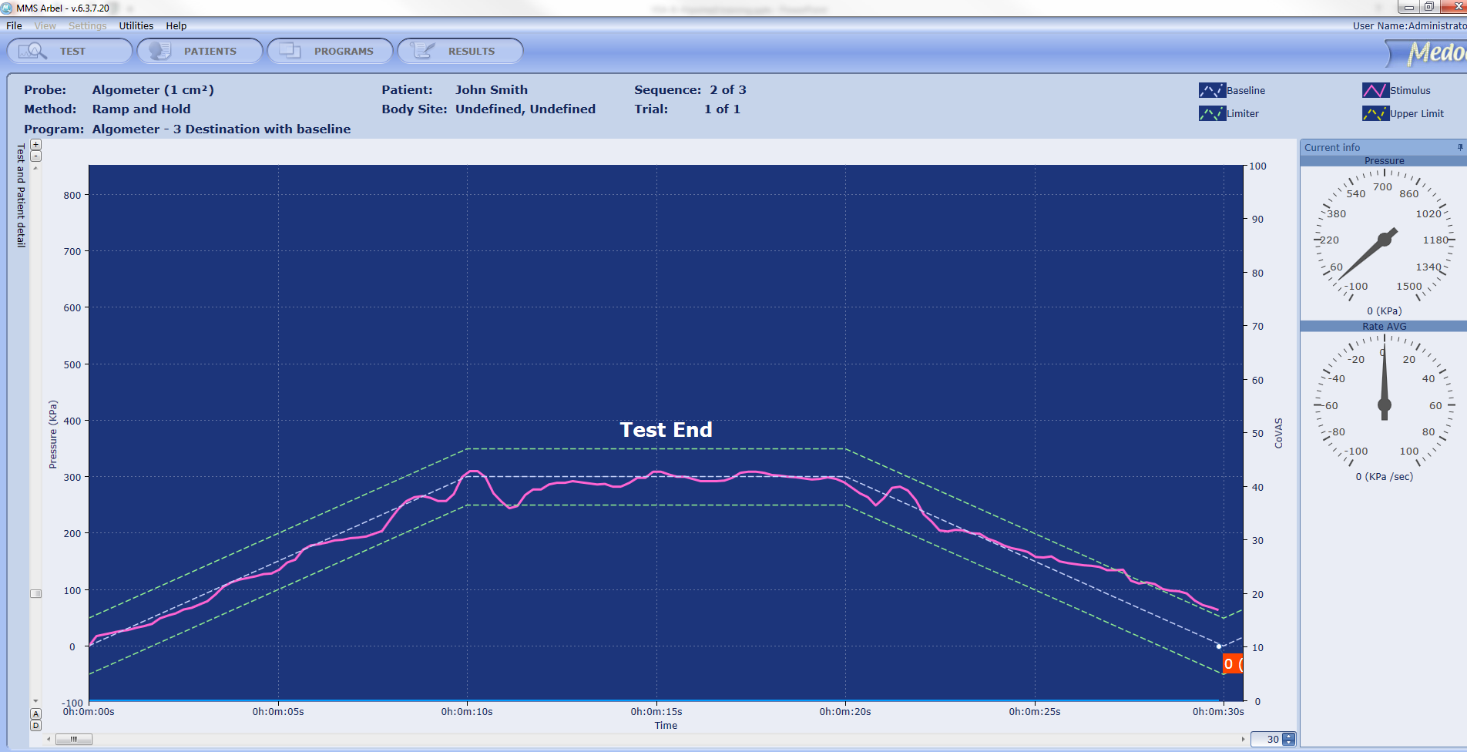
AlgoMed – Software Overview
Methods:
Limits – pain thresholds and pain tolerance
Ramp & Hold – advanced protocols (Temporal Summation)
Statistics and Reports
Notes:
Levels – A long but accurate way to find the detection threshold (cold / hot).
The threshold temperature is determined by oscillating above and below the threshold, until it is accurately determined (the exact point sensation turns from “0’ to “1”).
The “maximal”/”minimal” point is pre-set by the program and also changes if the patient detected change in temperature (so the next step will be a lower temperature) or could not detect change in temperature (so the next step will be a higher temperature).
Limits – a way to determine both pain and detection thresholds.
3-4 tests are done in a row after which the average pain threshold (or detection threshold) are given.
The “maximal”/”minimal” point of each test is determined by the patient - “I start feeling pain” or “I start detecting change in temperature”
Ramp & hold – a way to examine a broad variety of different protocols and heating / cooling scenarios.
The “maximal”/”minimal” point is pre-set by the program and the patient is asked what was the level of pain (0-100 scale = VAS) he/she felt at this pre-set maximal/minimal temperature
Windup (temporal summation) - occurs when a high frequency of action potentials in the presynaptic neuron elicits postsynaptic potentials that summate with each other.
Stimuli = action potential. A lot of stimuli = a lot of “firing” of action potentials ➔ creating a summation of all the potentials into a hot ball of pain.
Inhibition - ‘diffuse noxious inhibitory controls’ (DNIC) which explains the effectiveness of the commonly-known ‘pain-inhibits-pain’.
The term ‘‘conditioned pain modulation” (CPM) has been introduced to describe this psychophysical phenomenon, that allows pain inhibition of a painful stimulus by a second painful stimulus delivered at a different body location.
The brain circuitry responsible for CPM remains unknown.

Slide 5
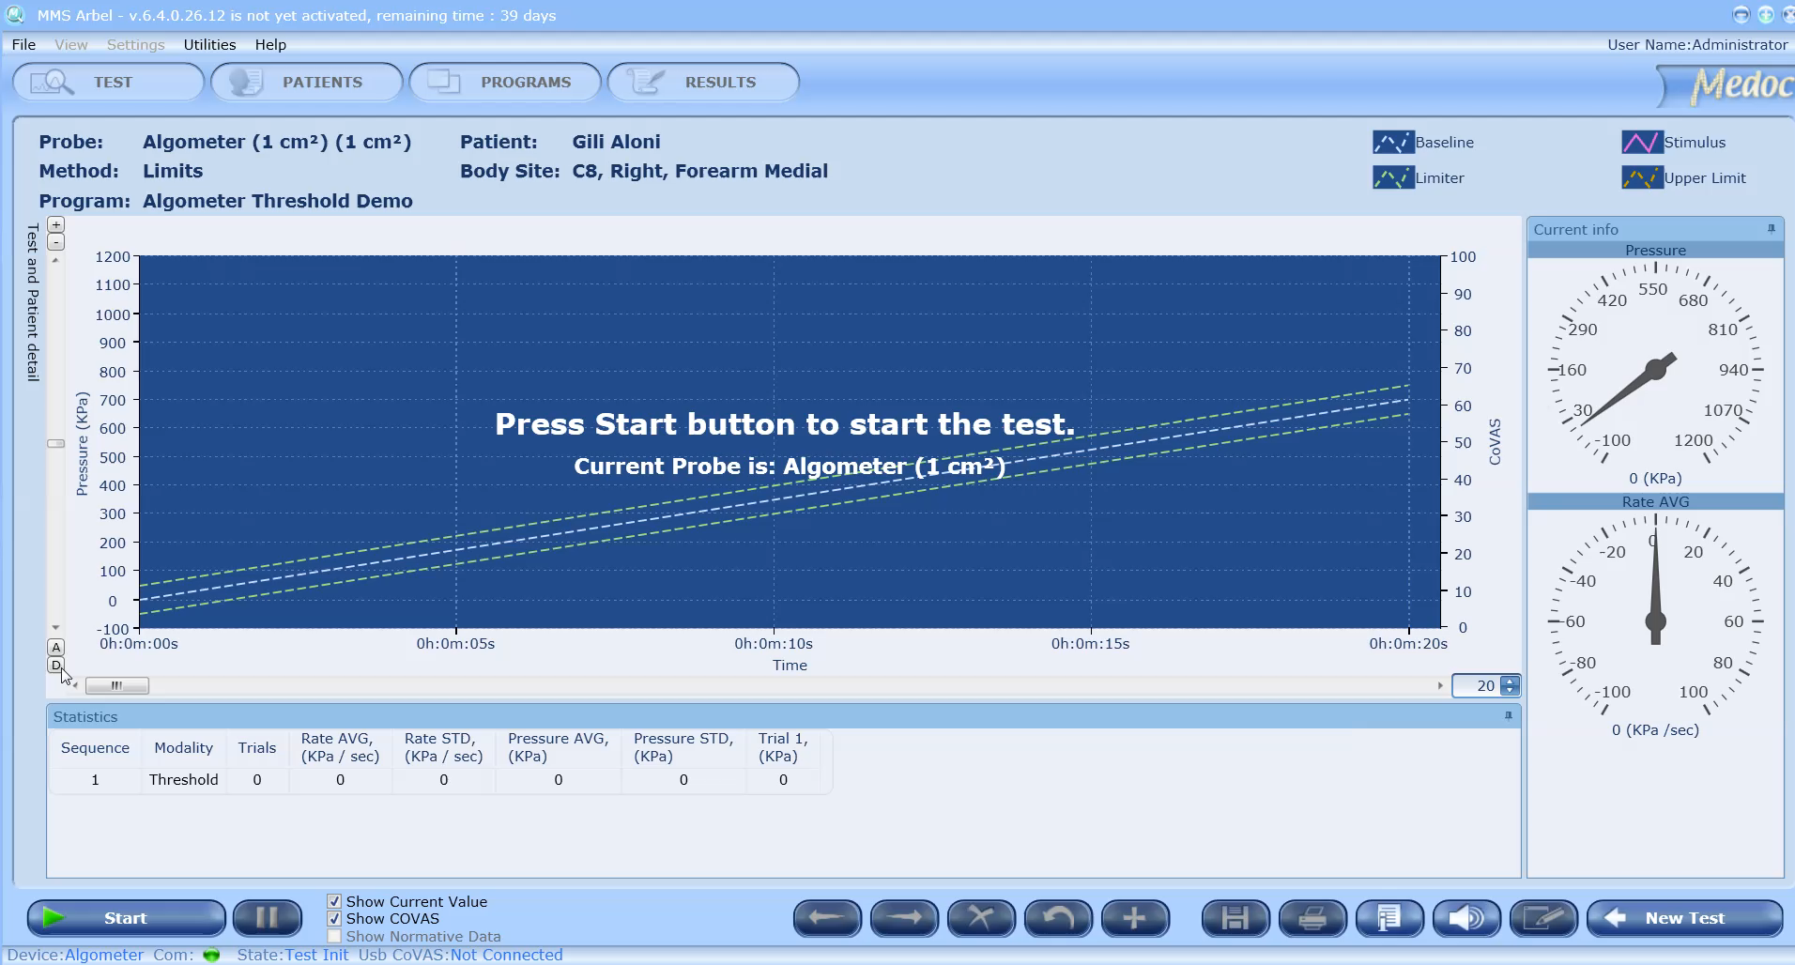
AlgoMed – Limits

Slide 6
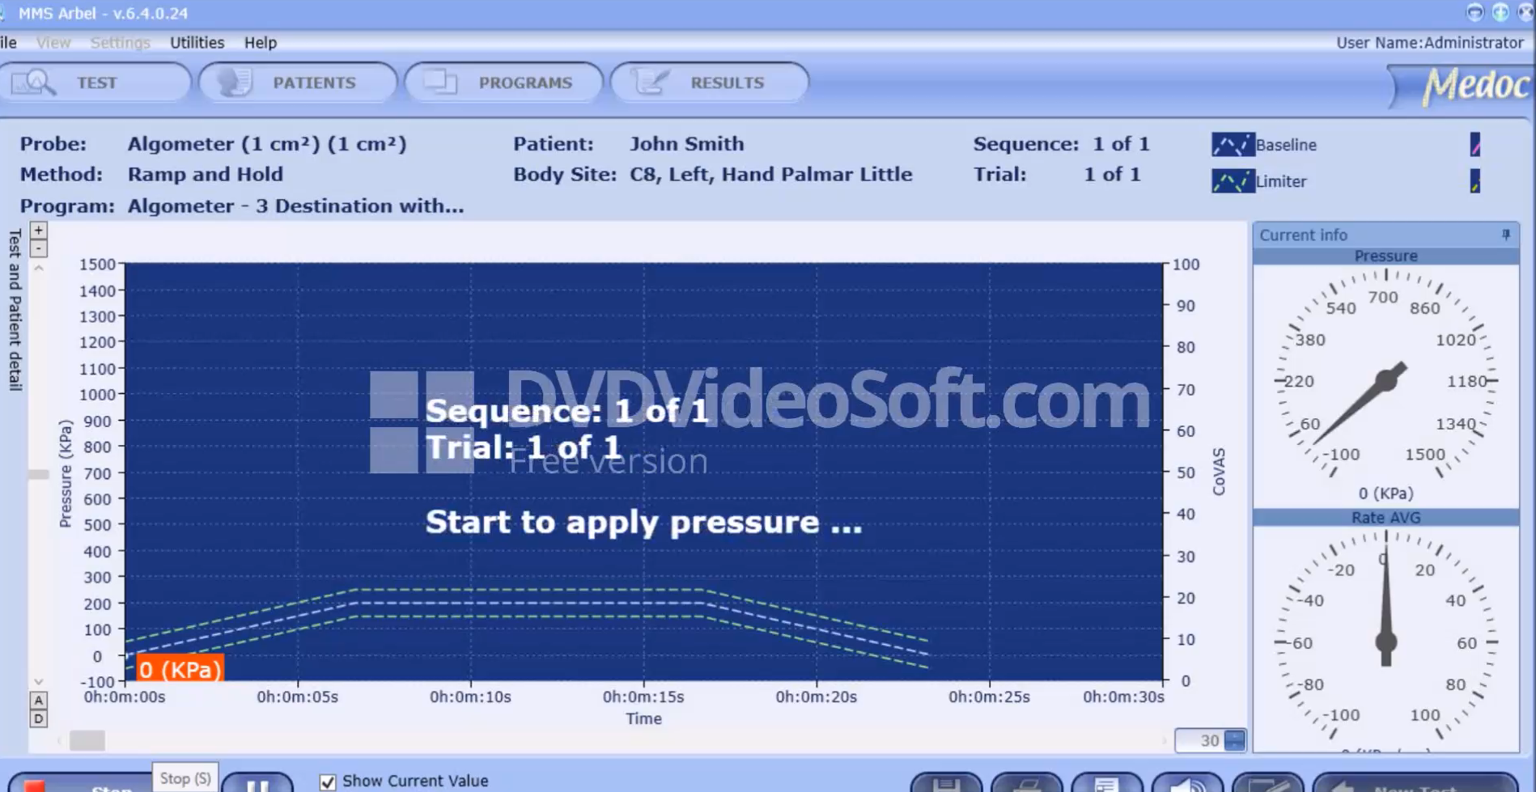
AlgoMed – Ramp and Hold

Slide 7
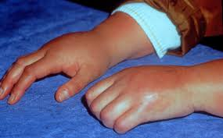
Algometry – Applications
QST
  Pressure Pain Threshold (PPT)
  Pressure Tolerance Threshold
  Conditioned Pain Modulation (as test pain)
  Tonic Pressure Temporal Summation
Disease course monitoring
  Osteoarthritis, Rheumatoid Arthritis, CRPS, fibromyalgia, myofascial pain, temporomandibular disorder, and others.
  Applicable to bones, joints, muscles, fascia, tendons and teeth
Treatment Efficacy Assessment
Notes:
QST – competitors. Small fibers mainly (pain modality). Normative values of DFNS
Fibromyalgia – tender points (18). At least 11 for diagnosis. In general – central sensitization and widespread pain. often triggered by a stressful event, including physical stress or emotional (psychological) stress. More common with women ← This is not relevant anymore, as the Budapest criteria have changed. But tender points may possibly still be used to monitor the state of the patient (?)
CRPS - Complex regional pain syndrome(CRPS), pain, swelling, limited range of motion, and changes to the skin and bones to one side of the body (foot/hand), typically occurs after an injury / surgery
Muscles and Tendons – OA, knee disorders
Dental and Myofacial – example: TMD patients are more sensitive;
Treatment – ketamine in CRPS; heperbaric oxygen therapy ; TMS and TDCS
CPM – mechanical test stimulus in m-s conditions evaluation

Slide 8
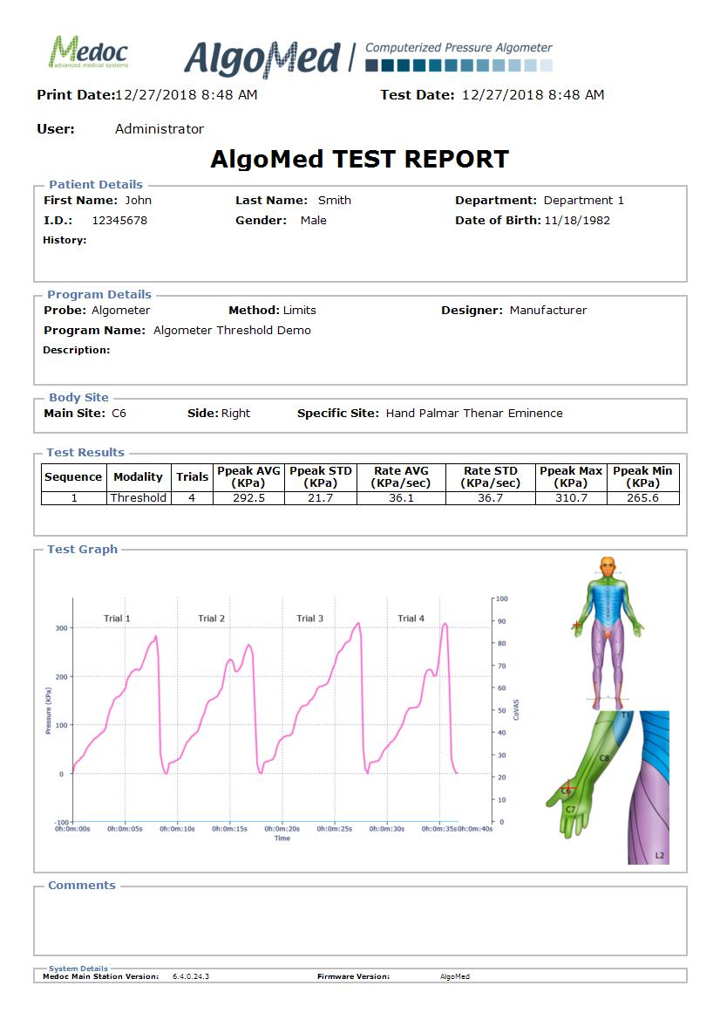
AlgoMed Benefits
Ergonomic handle
Various probe sizes
Intuitive software
Computer-guided ascent rate and control over pressure exertion
Automatic data collection and comprehensive patient report

Slide 9
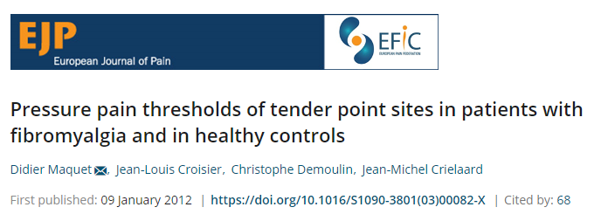
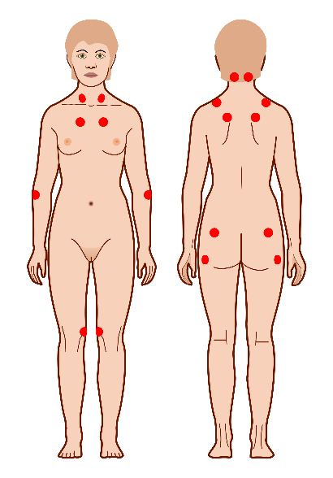
Fibromyalgia Syndrome (FMS)
Affects ~2-4% of people, women > men (ratio: 8:2)
Probably involves the central nervous system
PPTs may be used in the assessment of tender points
Most common symptoms:
  Widespread pain
  Fatigue
  Cognitive deficits
  (American College of Rheumatology, March 2017)
Notes:
https://www.accp.com/docs/bookstore/acsap/a15b1_m1sample.pdf

Slide 10
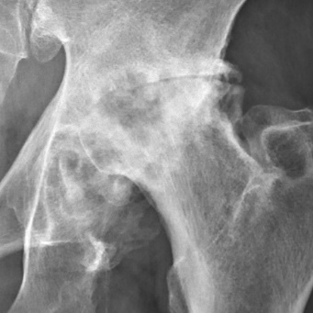
Osteoarthritis
Osteoarthritis is characterized by breakdown of the cartilage, bony changes of the joints, deterioration of tendons and ligaments, and various degrees of inflammation of the joint lining (called the synovium). (American College of Rheumatology, March 2017)
Most commonly affects older people.
OA affects over 30 million US adults. (CDC, September 2017)
Notes:
https://www.rheumatology.org/I-Am-A/Patient-Caregiver/Diseases-Conditions/Osteoarthritis
https://www.cdc.gov/arthritis/basics/osteoarthritis.htm

Slide 11
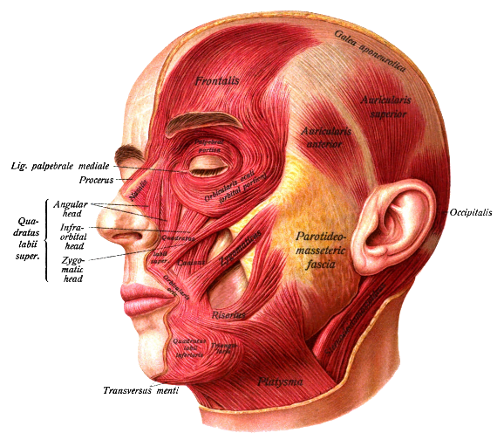
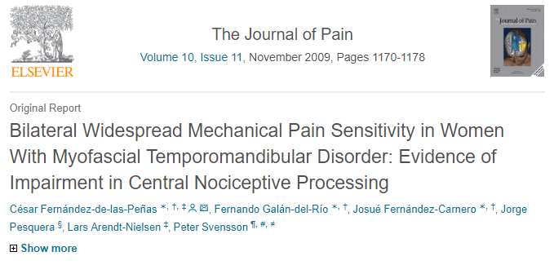
Temporomandibular joint disorder
TMJ disorders affect over 10 million Americans
More common in women than in men
Most common symptoms:
  Pain radiating to the jaw, face and neck
  Stiffness of the jaw muscles
  Limited jaw range of motion and locking
  Painful clicking during jaw movement
  (National Institute of Dental and Craniofacial Research, July 2018)
Notes:
https://www.sciencedirect.com/science/article/pii/S152659000900546X
https://www.nidcr.nih.gov/health-info/tmj/more-info

Slide 12
The Pharmaceutical Trials Market
Effectiveness and safety of prospective compounds for neurological, diabetic, and pain conditions can be established by examining small-fiber functionality using Medoc’s systems
Medoc products are used by world-renowned pharmaceutical companies conducting clinical trials; Pfizer, GlaxoSmithKline, Merck, AstraZeneca, Dainippon, Unilever, Quintiles, Pro-Derm, Sigma Tau, and others
Medoc’s AlgoMed is currently used in a large (~200 sites) clinical trial as a baseline and follow-up second efficacy measure

Slide 13
The Pharmaceutical Trials Market
Medoc’s systems can be used for a variety of applications in clinical trials:
Phenotyping
  Phenotyping of patients based on underlying pain mechanisms; allows to identify and selectively recruit patients who are expected to benefit from the treatment
Secondary outcome measures
  Quantitative and standardized secondary analgesic efficacy measures, to assess the analgesic efficacy and support extended labeling of the investigated compound
Safety
  The ability to monitor small fiber function and assure no ill-effects are caused by the investigated compound
Notes:
Analgesic compound have a very low success rate in clinical trials, it usually helps 10-15% of the tested patients.
So lets say we have 100 patients with diabetic neuropathy, of whom the new drug helps only 15 people.
But in many cases this is because the underlying mechanism of pain is different for patients with the same disorder, meaning the fibers are functioning badly due to different underlying reasons, and the drug effectively treats just one of the reasons.
So it’s now recommended to do Phenotyping – which is dividing patients to subgroups based their underlying pain mechanisms, so that we could identify and recruit only patients who are expected to benefit from the treatment. In our example, in stead of the original 100 patients we will take only 20. so the original 15 people who had a good response to the drug become a 75% success rate

Slide 14
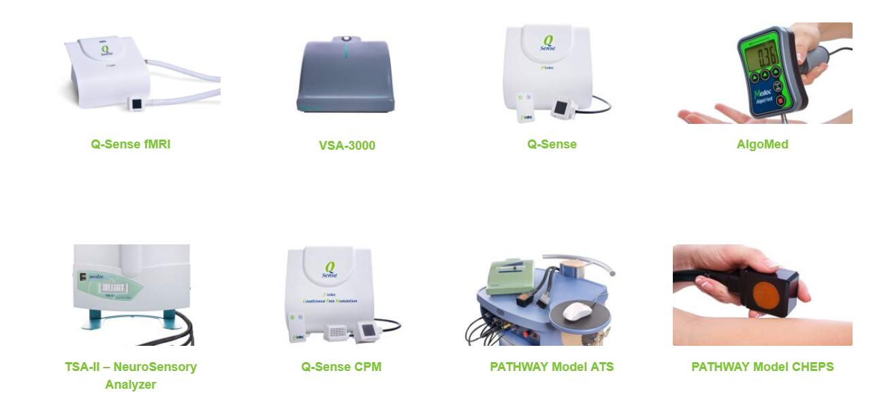
Find out more about our products https://medoc-web.com/

